Slide 1
Bode plot
Plots of the magnitude and phase characteristics are used to fully describe the frequency response
A Bode plot is a (semi log) plot of the transfer function magnitude and phase angle as a function of frequency
The gain magnitude is many times expressed in terms of decibels (dB)
dB = 20 log₁₀ A
BE (AERO) - V SEM - EE2365 CONTROL ENGINEERING

Slide 2
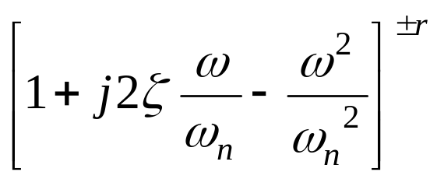
Bode plot procedure
There are 4 basic forms in an open-loop transfer function G(jω)H(jω)
Gain factor, K
(jω)±p factor: pole and zero at origin
(1+jωT)±q factor
Quadratic factor
BE (AERO) - V SEM - EE2365 CONTROL ENGINEERING

Slide 3
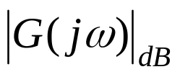

The magnitude and phase plots for some typical factors
Factor | Magnitude: | Phase:
Gain, K
jω
20logK
0dB
0dB
BE (AERO) - V SEM - EE2365 CONTROL ENGINEERING
90º
0dB
45º
1
20 dB/decade
0º

Slide 4
The magnitude and phase plots for some typical factors
Factor | Magnitude: | Phase:
jω²
1/jω
40logω
180º
0dB
90º
40 dB/decade
0º
1
BE (AERO) - V SEM - EE2365 CONTROL ENGINEERING
0º
0dB
-45º
-20 dB/decade
-90º

Slide 5
The magnitude and phase plots for some typical factors
Factor | Magnitude: | Phase:
1/jω²
1+jωT
-40logω
0dB
-40 dB/decade
BE (AERO) - V SEM - EE2365 CONTROL ENGINEERING
90º
45º
0º
0.1/T
1/T
10/T

Slide 6
The magnitude and phase plots for some typical factors
Factor | Magnitude: | Phase:
1/(1+jωT
0.1/T
BE (AERO) - V SEM - EE2365 CONTROL ENGINEERING
Corner frequency:
Magnitude plot can be approximated by asymptotic straight lines.
The frequencies corresponding to the meeting point of asymptotes are called corner frequency.
The slope of the magnitude plot changes at every corner frequency.

Slide 7
Gain margin and Phase margin
Gain margin:
The gain margin is the number of dB that is below 0 dB at the phase crossover frequency (ø=-180º). It can also be increased before the closed-loop system becomes unstable
Phase margin:
The phase margin is the number of degrees the phase of that is above -180º at the gain crossover frequency
BE (AERO) - V SEM - EE2365 CONTROL ENGINEERING

Slide 8
Gain margin and Phase margin
Magnitude
(dB)
20dB
0dB
-20dB
Gain Crossover
with 0dB line
Gain margin
-40dB
-60dB
Magnitude
curve
BE (AERO) - V SEM - EE2365 CONTROL ENGINEERING
Phase
curve
0º
Phase margin
Phase Crossover
with -180º line
-90º
-180º
-270º
Phase
(Degree)
Log ω

Slide 9

Steps involved:
Convert the given TF to Time constant form..i.e.
Identify the CFs….put it in ascending order…construct the table
Find out the starting point with the gain factor with the lowest frequency as (0.1 or 0.01),( along with the pole/zero at the origin)
Draw the magnitude plot
Write the phase angle expression and construct the table and find ф
Draw the phase plot, Find the FD Specifications ωgc, ωpc, Gain margin, Phase Margin

Slide 10
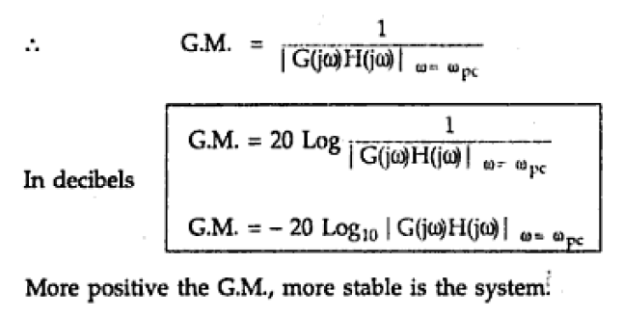
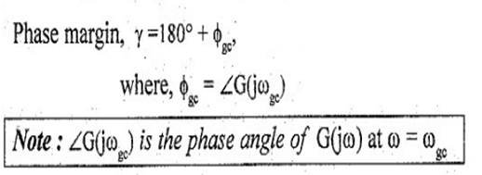
Gain Margin & Phase Margin

Slide 11


Slide 12
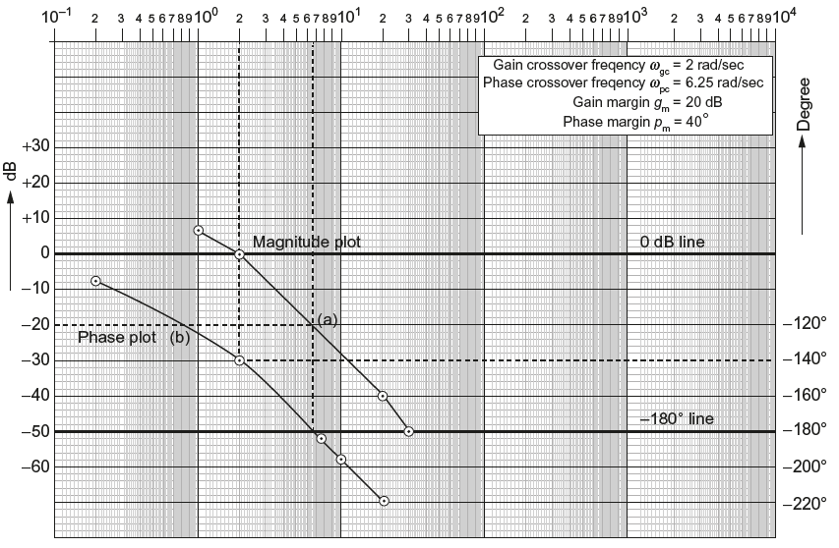
ILLUSTRATION

Slide 13
Bode Plot – Example 1
For the following T.F draw the Bode plot and obtain Gain cross over frequency (w_{gc}) , Phase cross over frequency , Gain Margin and Phase Margin.
G(s) = 20 / [s (1+3s) (1+4s)]
Solution: The sinusoidal T.F of G(s) is obtained by replacing s by jw in the given T.F
G(jw) = 20 / [jw (1+j3w) (1+j4w)]
Corner frequencies: wc₁= 1/4 = 0.25 rad /sec ; &
wc₂ = 1/3 = 0.33 rad /sec
Form a table
Term | Corner Frequency | Slope db/dB | Change in slope
20/jw | --- | -20 | Starting slope of -20dB up to 0.25
1/(1+j4w) | wc₁=1/4=0.25 | -20 | -20-20=-40( b/w 0.25 to 0.33)
1/(1+j3w) | wc₂=1/3=0.33 | -20 | -40-20=-60(b/w 0.33 to infinity)
BE (AERO) - V SEM - EE2365 CONTROL ENGINEERING

Slide 14
Calculation of Phase angle for different values of frequencies [PHASE PLOT]
Ø = -90^{O}- tan ⁻¹ 3w – tan ⁻¹ 4w
when
Frequency in rad / sec | Phase Angle in degrees
w=0 | Ø= -90º
w=0.025 | Ø= - 99º
w=0.25 | Ø= -172º
w=0.33 | Ø= -188º
w=3.3 | Ø= - 259º
w=∞ | Ø= - 270º
BE (AERO) - V SEM - EE2365 CONTROL ENGINEERING

Slide 15
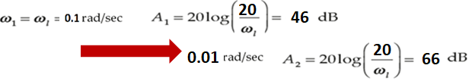
To obtain the starting point, consider the lowest value of ω as either 0.1 or as 0.01
Term | Corner Frequency | Slope db/dB | Change in slope
20/jw | --- | -20 | Starting slope of -20dB up to 0.25
1/(1+j4w) | wc₁=1/4=0.25 | -20 | -20-20=-40( b/w 0.25 to 0.33)
1/(1+j3w) | wc₂=1/3=0.33 | -20 | -40-20=-60(b/w 0.33 to infinity)

Slide 16
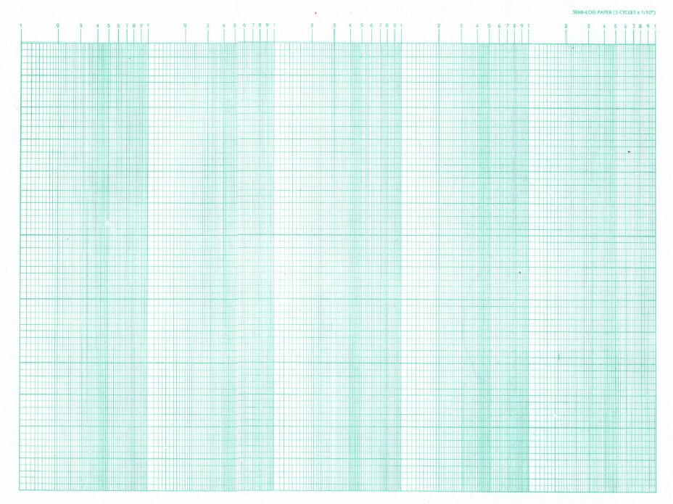
W =0.33
W_{h}=3.3
0.25 0.33
W₁ =0.25
60
-20 db/dec
Magnitude Plot
Y-Axis 1 unit =20 dB
-40 db/dec
40
+[G(jw)] in dB
X
32 dB
X
20
GM
-60 db/dec
W_{gc} =1.1 rad/sec
Log w
0
-20
GM = - [20 log G(jw_{pc})] dB
= - [32] dB = - 32 dB-
-40
-60
Phase Plot
Y-Axis 1 unit = 50º
Log w
-50º
BE (AERO) - V SEM - EE2365 CONTROL ENGINEERING
x
x
-100º
-150º
- 180º
x
x
-200º
Øgc=-240^{O}
PM
γ=180+φgc = 180º+(-240º)=- 60º
-250º
x
Ph. Angle
W_{pc} =0.3 rad/sec
-300º

Slide 17
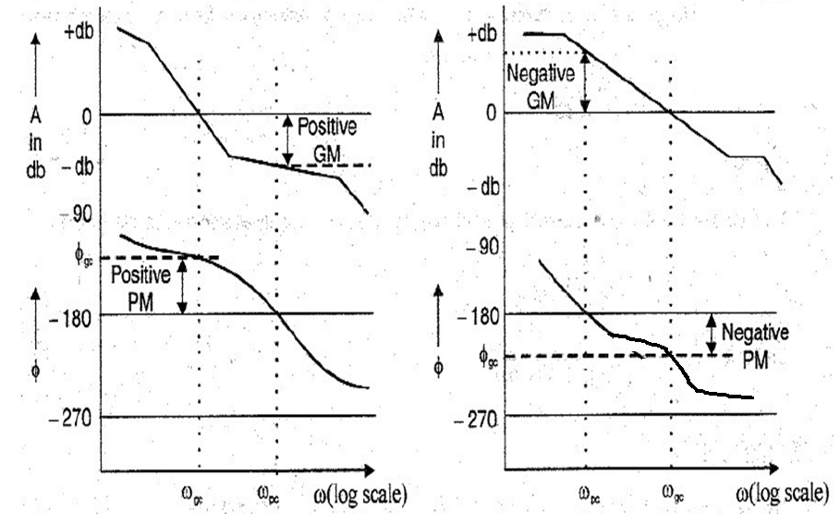

Slide 18

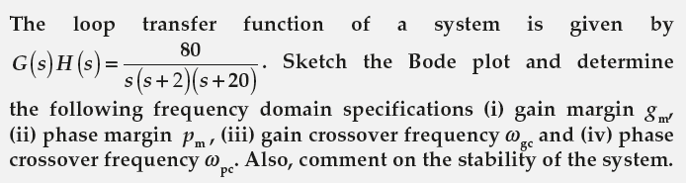
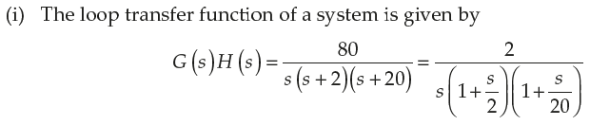
Problems in Bode Plot

Slide 19
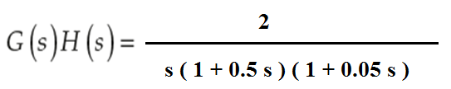

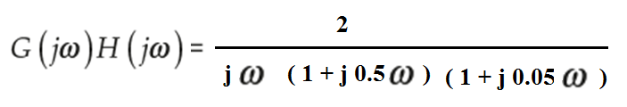
Problems in Bode Plot

Slide 20




Problems in Bode Plot

Slide 21


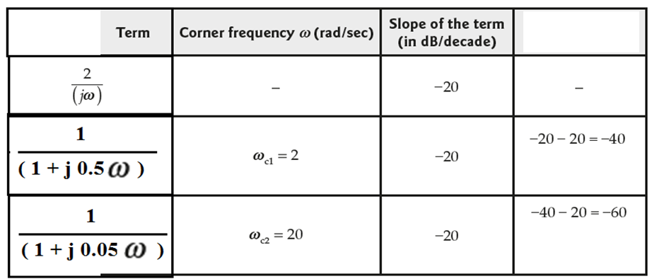
Problems in Bode Plot
Change
in slope
-20 slope
up to 2
( b/w 2 to 20)
slope is -40 db/dec
( b/w 20 to infinity
slope is -60 db/dec

Slide 22

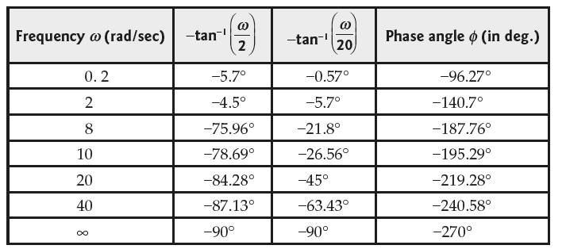

Slide 23


To find the starting point by considering the lowest value of ω as either 0.1 or as 1
-20 dB/dec
-40 dB/dec
-60 dB/dec

Slide 24
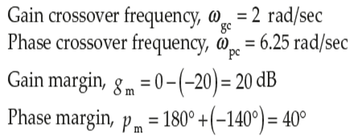
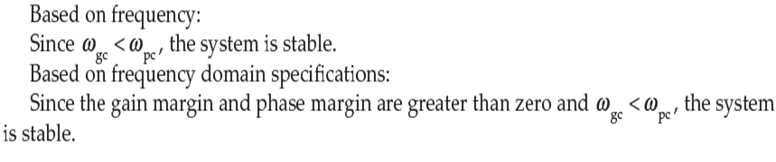

Slide 26




Problems in Bode Plot

Slide 27
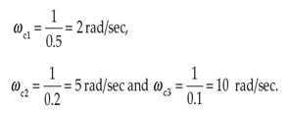
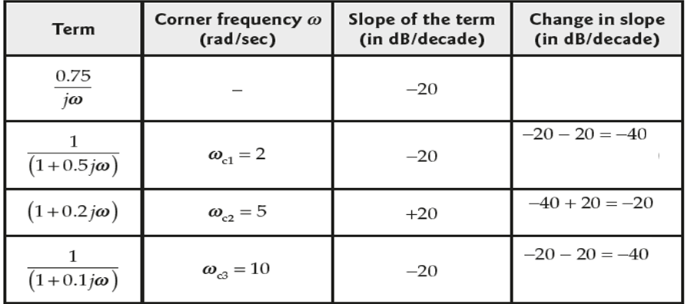
Problems in Bode Plot
Starting slope of -20 upto CF of 2
( b/w 2 to 5)
slope is -40 db/dec
(b/w 5 to 10
slope is -20 db/dec
(from 10 to infinity
slope is -40 db/dec

Slide 28
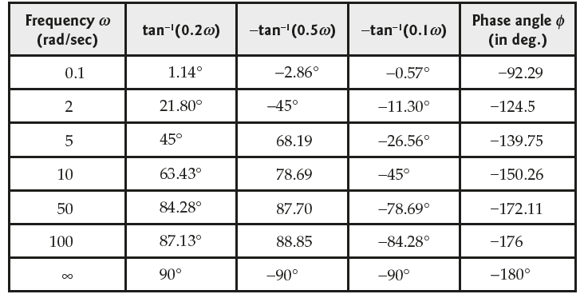
Problems in Bode Plot

Slide 29


To obtain the starting point, consider the lowest value of ω as either 0.1 or as 1

Slide 30
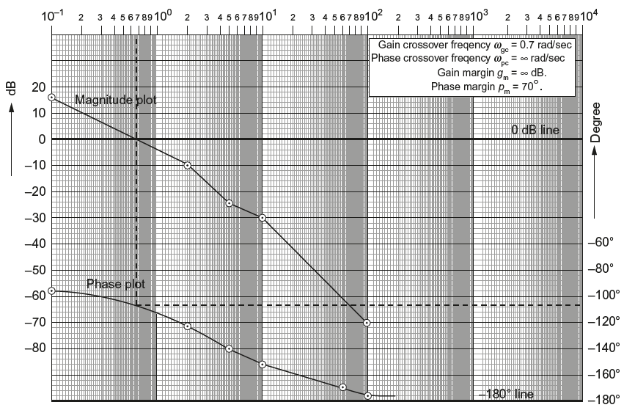
Problems in Bode Plot
-20 dB/dec
-40 dB/dec
-20 dB/dec
-40 dB/dec

Slide 31
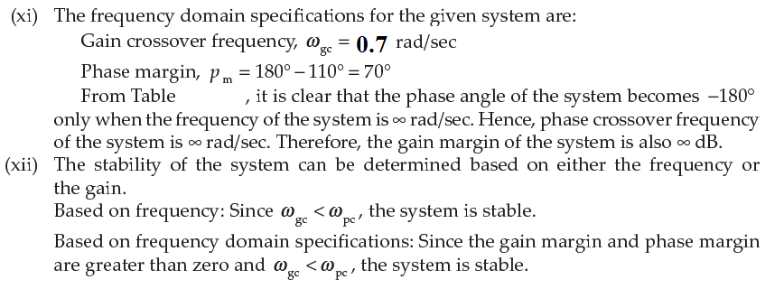
Problems in Bode Plot

Slide 33

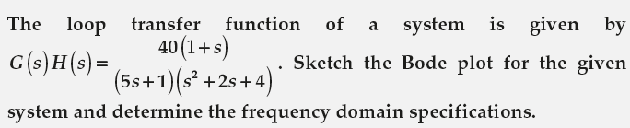

Problems in Bode Plot

Slide 34


Problems in Bode Plot

Slide 35


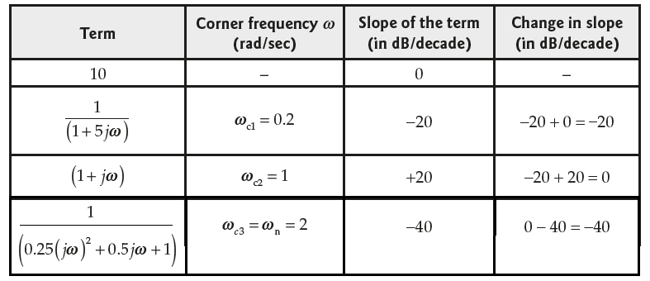
Problems in Bode Plot
Starting slope 0 dBUp to 0.2,
From 0.2 to 1 slope is -20
From 1 to 2 slope is 0db
From 2 to infinity,
slope is -40

Slide 36
60
W3 = 50
Magnitude Plot
Y-Axis 1 unit =20 dB
W₁ = 0.5
W2 = 5
40
+[G(jw)] in dB
0 db/dec
20
X
-20 db/dec
X
X
Log w
0
-40 db/dec
-20
-40
-60
Phase Plot
Y-Axis 1 unit = 50º
Log w
-50º
-100º
PM
-150º
-200º
γ=180+φgc
-250º
Ph. Angle
-300º

Slide 37
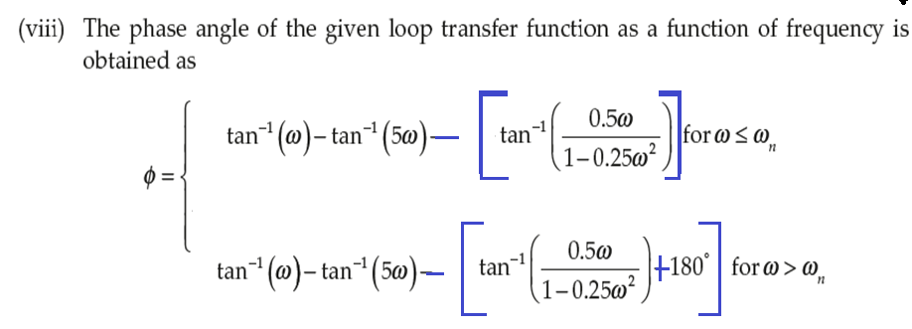
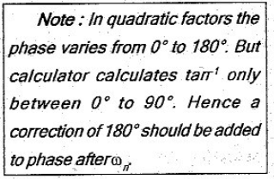
Problems in Bode Plot

Slide 38
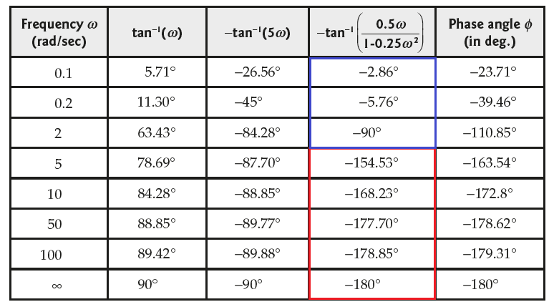
Problems in Bode Plot

Slide 39
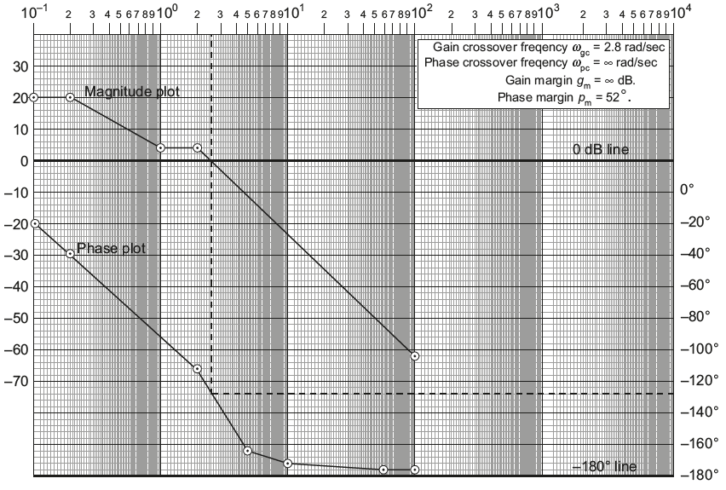
Problems in Bode Plot

Slide 40
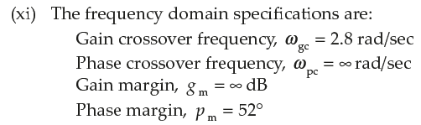
Problems in Bode Plot

Slide 41



Thank you

Slide 42
W₁ = 0.5
W2 = 2
W3 = 50
60
Magnitude Plot
Y-Axis 1 unit =20 dB
40
+[G(jw)] in dB
20
Log w
0
-20
-40
-60
Phase Plot
Y-Axis 1 unit = 20º
0º
-20º
-40º
-60º
-80º
Ph. Angle
-100º
0.1
1
10
100
1000

Slide 45

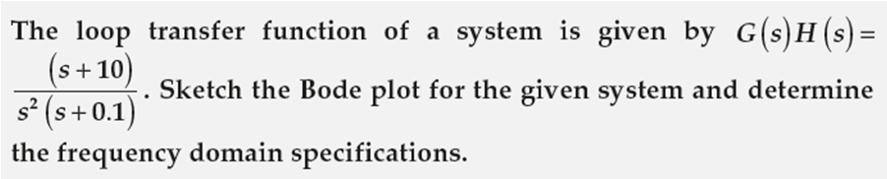
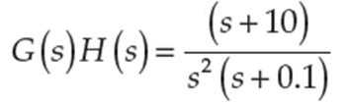
Problems in Bode Plot

Slide 46


Problems in Bode Plot

Slide 47

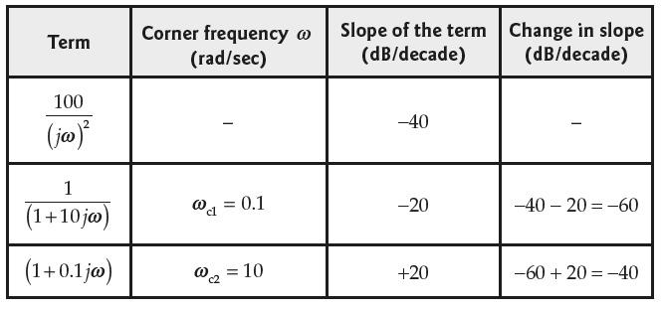
Problems in Bode Plot

Slide 48

Problems in Bode Plot

Slide 49
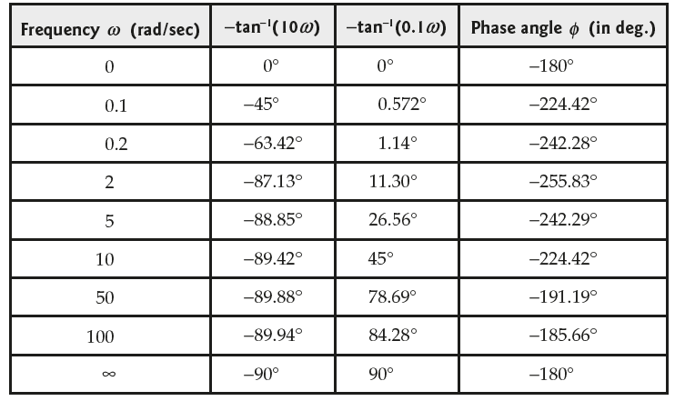
Problems in Bode Plot

Slide 50
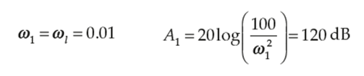
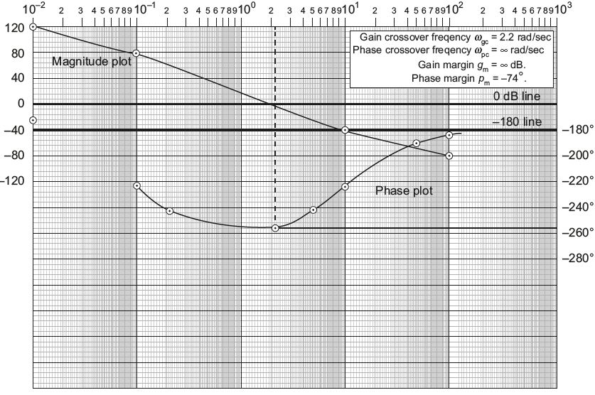
Starting point at 0.01,
-40 dB/dec
-60 dB/dec
-40 dB/dec

Slide 51
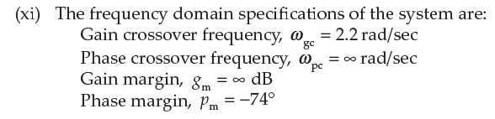
Problems in Bode Plot

